Slide 1


SSIE 516 Western Interconnect – towards Senate bill 100
By Group 5
Athira Nirmal and Soundarya Ketharaman
Notes:
A

Slide 2

Agenda
Introduction
Western Interconnect Overview
Motivation
Data Preprocessing and Exploratory Data Analysis
Methodology
Results Analysis
Future Work
Notes:
A

Slide 3
Introduction
Explores the structure, regulation, and characteristics of the energy sector in the Western Interconnect region of the United States.
Examine generation mix, transmission networks, energy demand, and key policies shaping the region's energy landscape.
OBJECTIVE
Western Electricity Coordinating Council
Maintains a reliable electric power system in Western Interconnect
Support effective competitive power markets
Assures open and non-discriminatory transmission
WECC control areas have signed RMS (Reliability Management System) agreement
WECC
Notes:
A
WECC Control Areas Have Signed RMS (Reliability Management System) Agreement
The Reliability Management System (RMS) agreement ensures WECC control areas:
Coordinate reliability efforts: Collaborate to maintain grid reliability.
Share resources: Share expertise, data, and resources to enhance reliability.
Adhere to standards: Comply with WECC's reliability standards and guidelines.

Slide 4
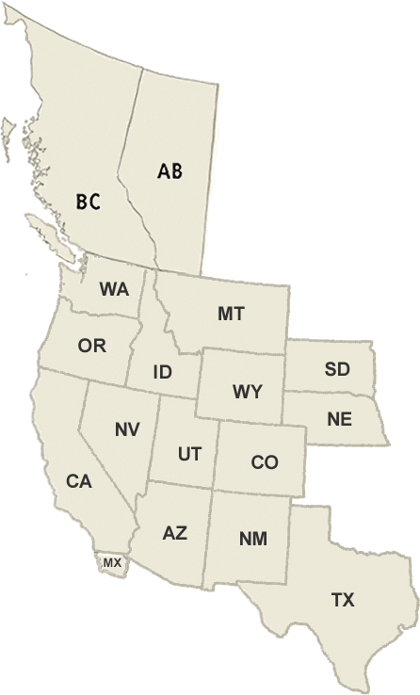
WESTERN Interconnect overview
90 Million People
167,745 MW
809,018 GWh
Interconnection peak demand
Total generation
893 Million MWh
156,000
2023 Annual demand
Miles of transmission lines
163,746 MW
299.5 GW
Total installed capacity
2023 Peak demand
15 GW
20% increase
New resources
Annual demand 2023 – 2024
Covers 14 western states, parts of Texas, Mexico and Canada
Notes:
A 809,018 GWh of electricity was generated, meeting the annual demand of 893Million MWh and peak demand of 163,746 MW, with a 20% increase in annual demand
Transmission and Capacity: The grid has 156,000 miles of transmission lines and a total installed capacity of 299.5 GW
Peak demand: This is the highest demand for electricity within the Western Interconnect during a specific moment or period in 2023.

Slide 5




Sectoral energy consumption
Residential Sector
Commercial Sector
Industrial Sector
Transportation Sector
Percentage of total electricity consumption: 37.4%
Seasonal variation:
Higher in summer and winter
Extreme climates
Key factors influencing consumption:
Temperature extremes
Humidity
Household income and size
Percentage of total electricity consumption: 33.4%
Key areas: California, Nevada, Seattle and Portland
Significant sectors:
Services (e.g., finance, healthcare, and tourism)
Retail and hospitality
Percentage of total electricity consumption: 24.1%
Key states: California, Arizona, Nevada, Utah, Oregon, and Washington
Major industries:
Technology and manufacturing
Mining
Percentage of total electricity consumption: 3.1%
Key factors driving growth:
Increasing electric vehicle (EV) adoption
Expansion of public charging infrastructure
Government incentives and policies supporting EV adoption
States with high EV adoption:
California, Oregon, Washington
Notes:
A

Slide 6
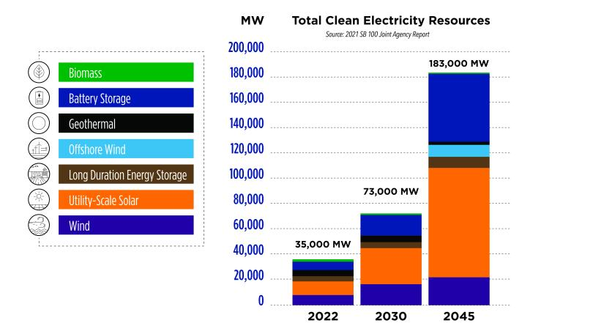
California Senate bill 100
2021 SB 100 Joint Agency Report
Total Clean Electricity Resources Forecast
Policy requires renewable energy and zero-carbon resources supply 100 percent of electric retail sales by 2045
Takeaways from Electricity System Modeling:
“Diversity in energy resources and technologies lowers overall costs.”
“Increased energy storage and advancements in zero-carbon technologies can reduce natural gas capacity needs.”
Notes:
S

Slide 7
Problem statement
Minimize the total system cost, including:
Fixed Costs:
Generation, storage, and transmission
Variable Costs:
Generation and non-served energy costs
Cost Optimization
Maximize the utilization of renewable energy sources such as solar, wind, and hydro power to reduce reliance on fossil fuels
Renewable Integration
Significantly decrease carbon dioxide emissions by optimizing energy production and promoting renewable energy adoption
CO2 Emission Reduction
Notes:
S

Slide 8
Why is it important?
Electric Grid:
Reliable 100% zero-carbon electricity by 2045
Grid modernization and reliability in Westen Interconnect
Environmental Benefits:
Reduced greenhouse gas emissions
Improved air and water quality
Economic Advantages:
Accelerated research in storage technologies
Increased job creation
Notes:
S

Slide 9
assumptions
Geographic diversification scenario – “Expanded regional transmission allowing for greater energy exchanges between California and the rest of the WECC” – is considered
Dataset as part of SR01 is sufficient for the capacity expansion model
RPS eligible resources for California are biomass, small hydroelectric, geothermal, wind, and solar
RPS target value is set to 1 in alignment with SB100 policy for the year 2045
Notes:
S

Slide 10
Let's talk about data
Datasets
Fuels_data
Generators_data
Generators_variability
Load_data
Network
Collect required attributes
Add more data
(RPS eligible resources)
Generators: Describes different technologies used with respect to each region along with the various costs and cap
Demand: Describes demand for various zones at each time index
Variability: Describes time-series data for capacity factor and resource availability
Fuels data: Describes cost and CO2 content for each fuel type
Lines: includes data on transmission fixed costs, capacity parameters, and loss parameters
Generators: 297×30 DataFrame
Demand: 672×6 DataFrame
Variability: 672×297 DataFrame
Fuels_data: 8×3 DataFrame
Lines: 6×12 DataFrame
Notes:
A

Slide 11
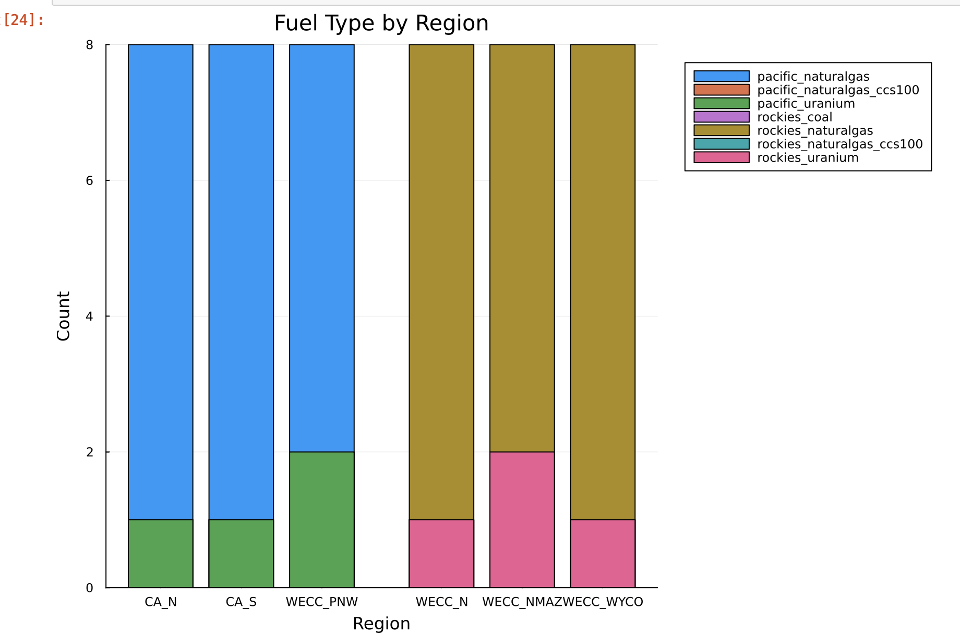
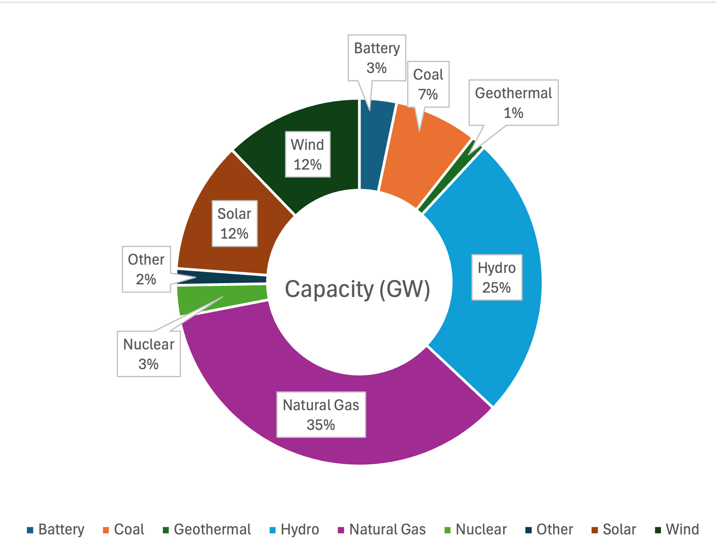
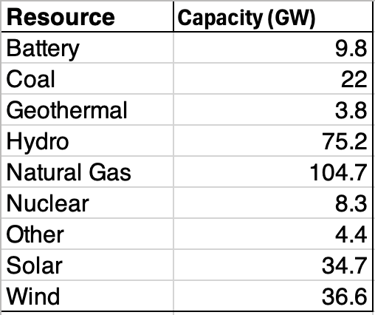
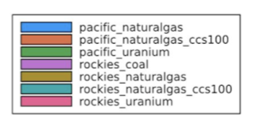
Energy statistics
2023 Total Installed Capacity (GW)
Notes:
A

Slide 12
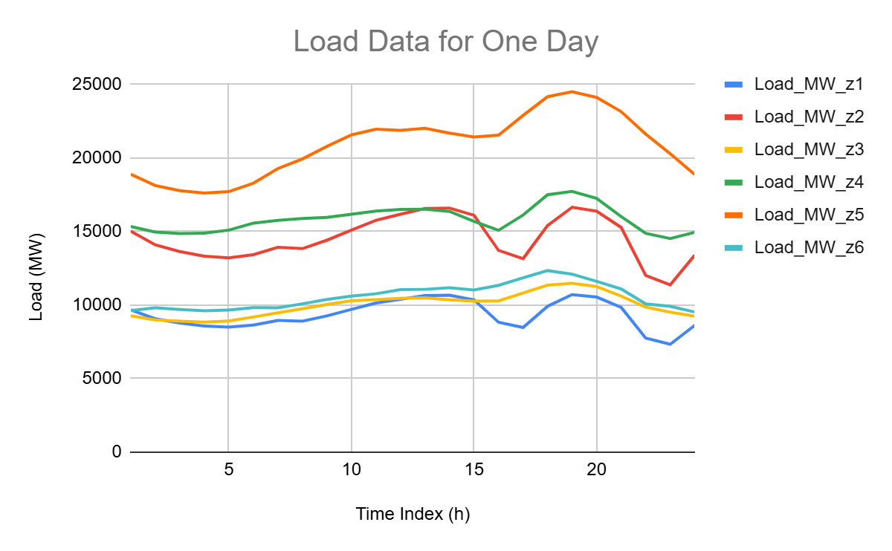
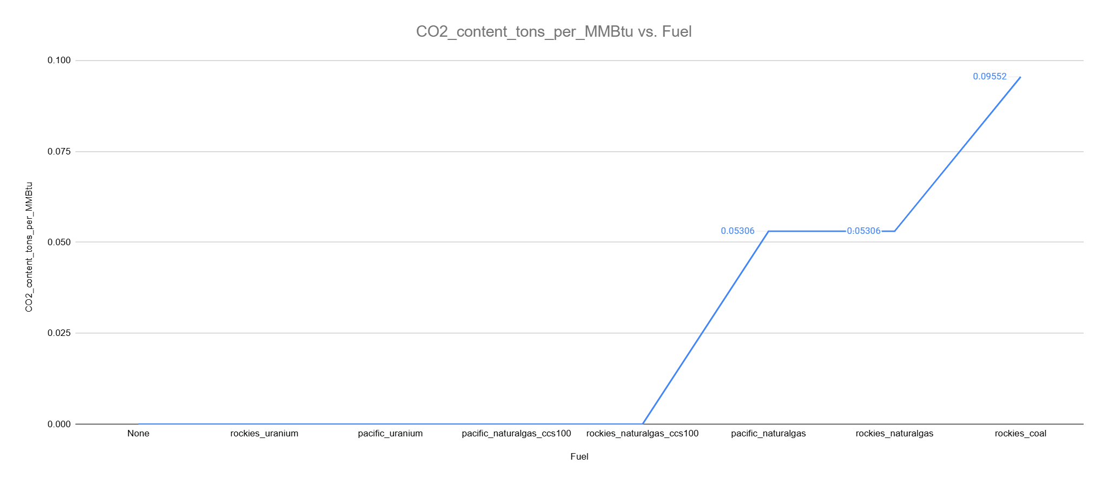
Data visualization
Fuel_data for CO2 Content
Load Data for One Day in January
Notes:
S

Slide 13

Methodology
Western Interconnect Dataset (4w)
Constraints
Supply-demand balance constraint for all time steps and zones
Max power, charge, SOC, NSE constraints for all time steps and all generators/storage
Max and min flow constraints for all time steps and all lines
Total capacity constraints for all generators/storage
Ramp up and down constraints along with storage SOC for normal and sub-wrapping
Inclusion of total CO2 emission transmitted cap constraint (CT Model)
Inclusion of Renewable Portfolio Standard (RPS) constraint
Base Model
CT Model
RPS Model
Z = Minimize fixed cost for generation, storage, and transmission, variable costs, and NSE costs
Notes:
S

Slide 14
MODEL 1 – Base Model
OBJECTIVE FUNCTION
Minimize the total cost, increase renewable sources
CONSTRAINTS
Demand Balance:
Ensures that generation, storage, and transmission meet demand in every time step and zone
Capacity Limits:
Restricts generation, storage, and transmission within their maximum capacities
Storage Constraints:
Limits on charging, discharging, and state-of-charge (SOC) of storage units
Transmission Flow:
Ensures flows on transmission lines respect capacity and directionality
Ramp Constraints:
Limits how quickly generators can increase or decrease their output between time steps
Coupling of Time Periods:
Links variables across time steps to account for ramp rates, storage SOC, and sub-period wrapping
Notes:
A

Slide 15
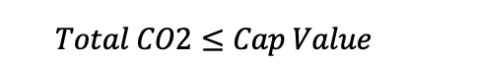
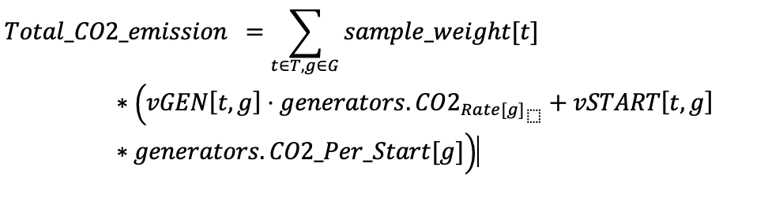
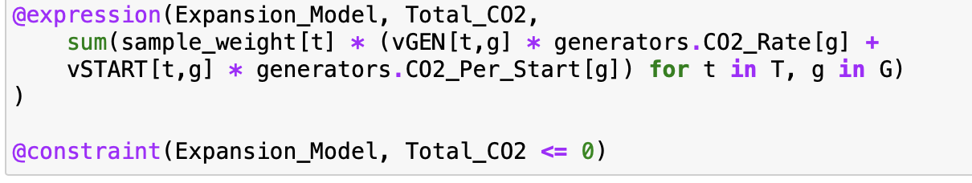
MODEL 2 – CT Model
OBJECTIVE FUNCTION
Minimize the total cost, increase renewable sources, decrease CO2 emission
CONSTRAINTS
CO2 emissions rate = fuel CO2 content * heat rate
Start-up CO2 emissions = fuel CO2 content * start up fuel use
Set the Cap Value as necessary, our model assumes 0% CO2 emission!
Notes:
A

Slide 16
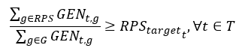
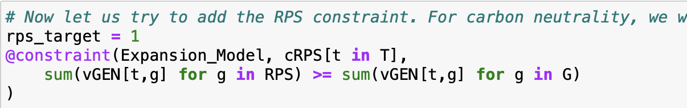
MODEL 3 – rps model
OBJECTIVE FUNCTION
Minimize the total cost, increase renewable sources, decrease CO2 emission with RPS policy
CONSTRAINTS
Added new constraint for RPS
Notes:
A
Ratio of Sum of all the RPS eligible generators to the SUM of all the generators should be greater than the target value of RPS

Slide 17
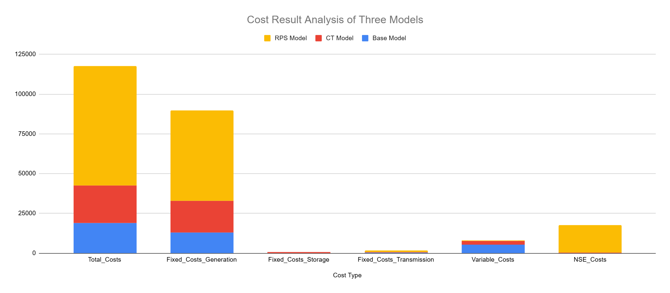
Cost result Analysis
Base Model minimizes total costs through lower fixed generation and NSE costs
CT Model incurs higher fixed costs for generation and storage
RPS Model has high fixed generation costs and high NSE costs, leading to the highest total costs
Notes:
S

Slide 18
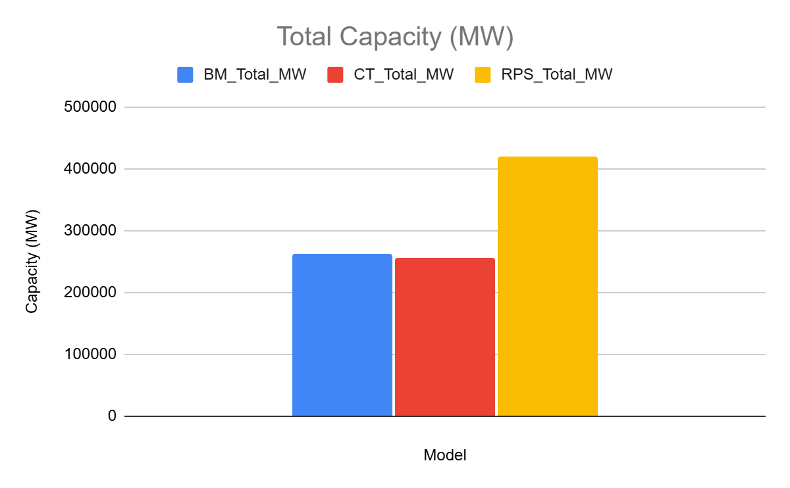
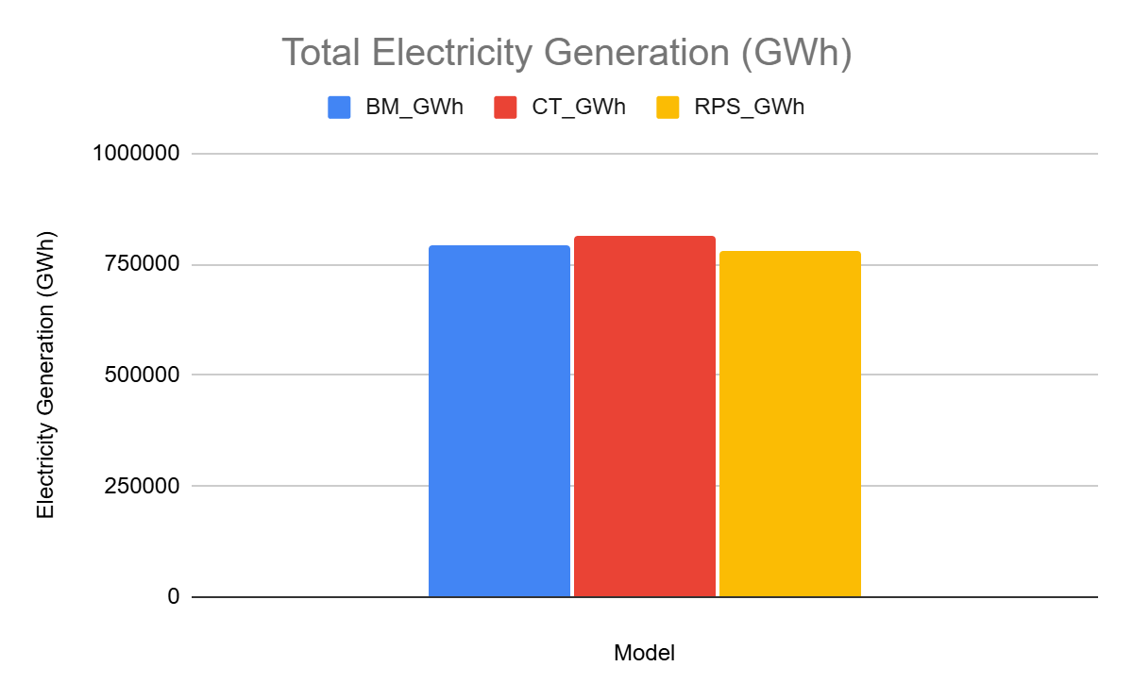
Generators result Analysis
The RPS Model generates significantly higher total MW but achieves lower total GWh, indicating inefficiency in energy utilization due to renewable integration.
The CT Model balances moderate MW and the highest GWh, suggesting improved operational efficiency compared to the Base Model.
Notes:
S

Slide 19
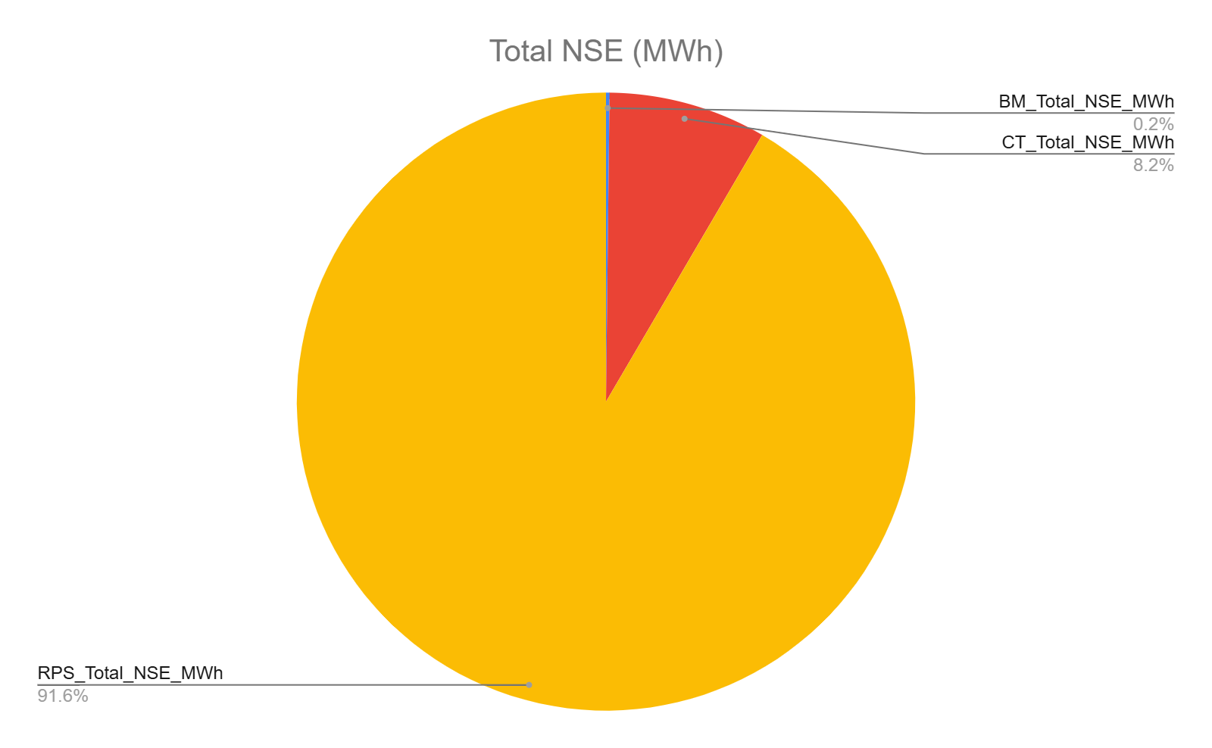
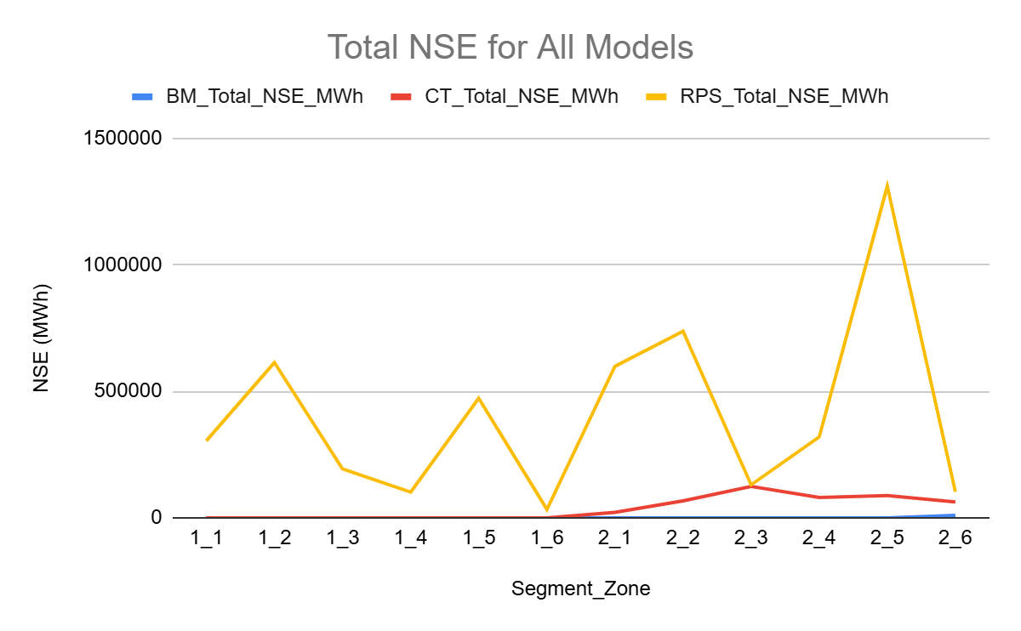
NSE Results analysis
The RPS Model has highest NSE across all segments indicating challenges in meeting demand despite higher MW capacity
Base Model demonstrates reliable energy delivery, achieving near-zero NSE
Notes:
S

Slide 20
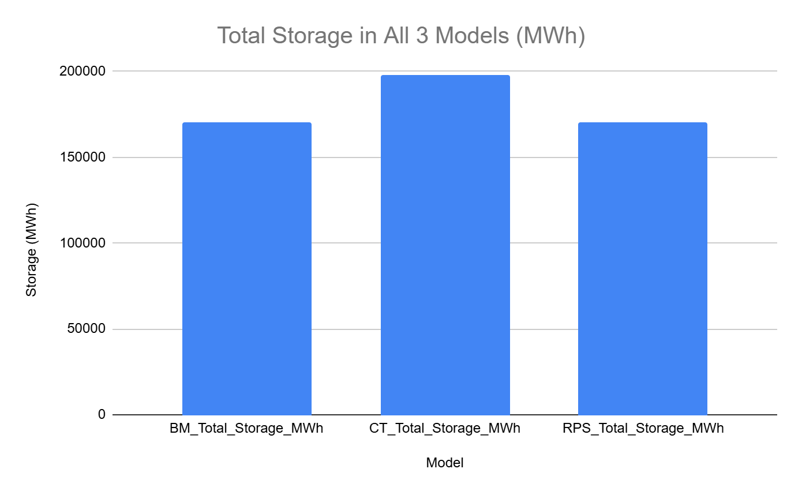
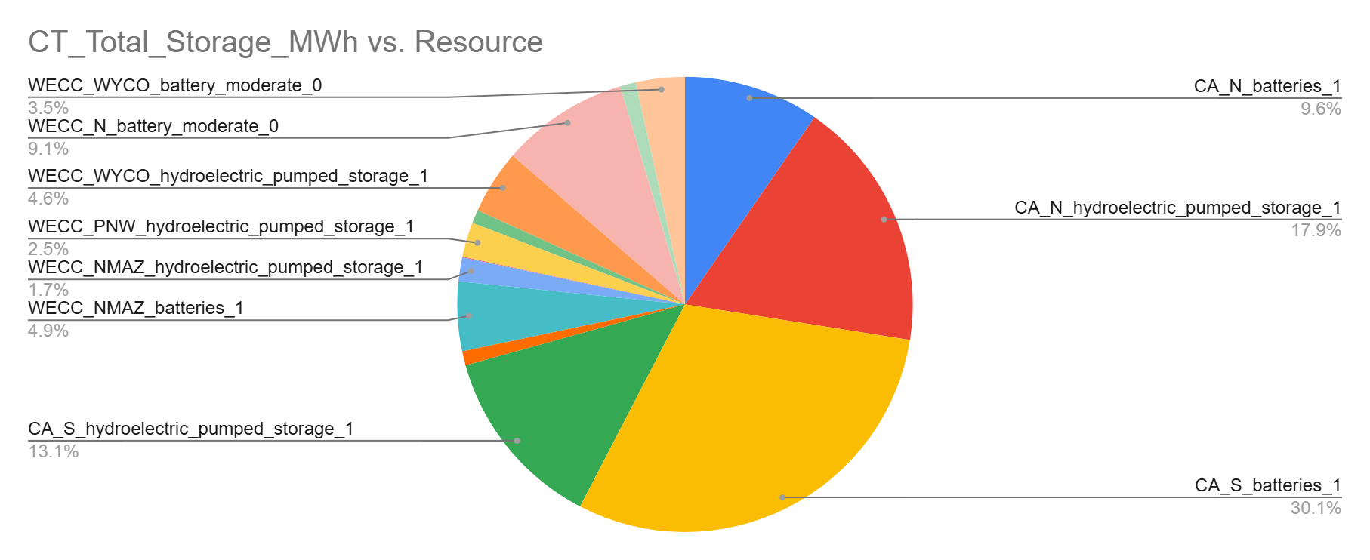
storage Results analysis
The CT Model increases total storage utilization compared to the Base Model and RPS Model, balancing emissions trading with storage strategies
RPS does not utilize additional storage despite its higher NSE
Notes:
S

Slide 21
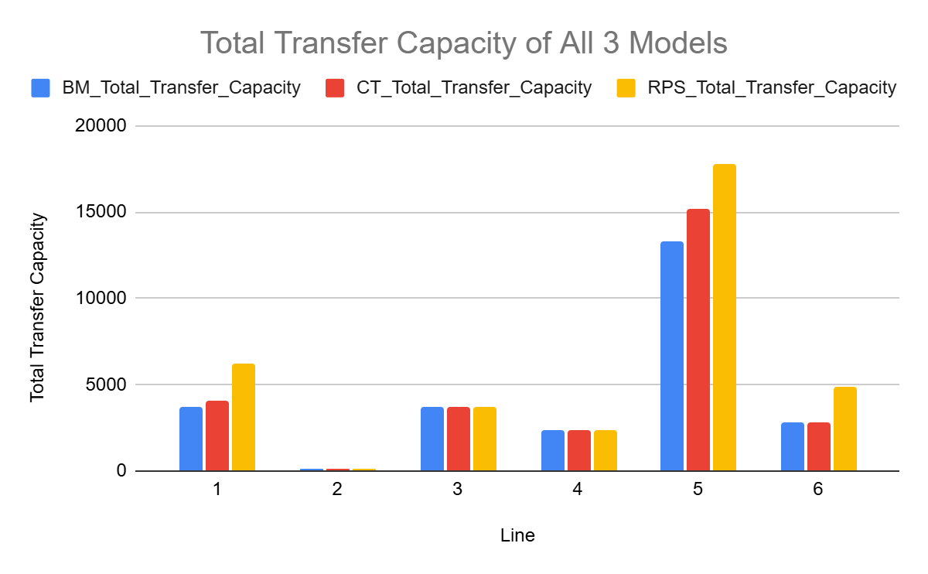
transmission Results analysis
The RPS Model has highest transfer capacity inferring importance of a reliable transmission infrastructure to meet the standard
Notes:
S

Slide 22
Limitations
Ignored socioeconomic factors
Limited emissions scope
The model does not consider the social or economic impacts of policies, such as job creation, regional equity, or energy access
The focus is only on CO₂ emissions from the power sector, ignoring other greenhouse gases (e.g., methane) or emissions from other sectors (e.g., transportation, industry)
Absence of consumer behavior
Limited policy interactions
The model does not incorporate the potential impacts of demand-side management or consumer behavior changes in response to carbon pricing or renewable policies
The interactions between cap-and-trade and a clean electricity standard are not analyzed in detail, which may overlook potential synergies or conflicts between these policies
Notes:
A

Slide 23
Future work
Run model for 1 year
Run sensitivity analysis on storage resources to explore impact on total NSE
Explore inclusion of Cap-and-Trade policy as constraint to examine effect on total costs
Notes:
S

Slide 24
References
https://www.pnnl.gov/main/publications/external/technical_reports/PNNL-36452.pdf
https://www.energy.gov/sites/prod/files/2016/04/f30/Western-Gridoverview.pdf
https://feature.wecc.org/soti/index.html
https://www.energy.ca.gov/sb100
https://www.energy.ca.gov/programs-and-topics/programs/renewables-portfolio-standard
https://wci-inc.org/
Lew, Debra & Brinkman, G. & Ibanez, Eduardo & Florita, Anthony & Heaney, M. & Hodge, Bri-Mathias & Hummon, Marissa & Stark, Greg & King, J. & Lefton, S.A. & Kumar, Nikhil & Agan, Dwight & Jordan, G. & Venkataraman, Sundar. (2013). The Western Wind and Solar Integration Study Phase 2.

Slide 25



Thank you

